Slide 1
Text Analysis Using Machine Learning
Guide Name:
Mr. G. Balram
(Asst. Professor)
Dept. of CSE
Team Details:
Gajam Nikhil (19H61A05D5)
E. Kruthik Reddy (19H61A05D1)
Gadipe Dolly (19H61A05D4)

Slide 2
ABSTRACT
This project is focused on analyzing and processing textual data, using a combination of techniques including spam detection, text summarization, and emotional analysis. The aim of the project is to provide users with a comprehensive understanding of the text they are analyzing, including its overall sentiment, relevance, and potential for spam or malicious content. The spam detector module analyzes the text for common spam keywords and phrases, flagging any potential spam or malicious content. The text summarization module summarizes the content of the text, providing a brief and concise overview of its most important points. The emotional analysis module evaluates the overall sentiment of the text, identifying positive or negative emotions and providing a sentiment score. The project uses a variety of machine learning and natural language processing techniques to analyze the text, including neural networks, sentiment analysis algorithms, and statistical modeling. The system is designed to be highly scalable and flexible, allowing it to be customized for a wide range of applications and industries. The project has the potential to be used in a variety of applications, including social media monitoring, customer feedback analysis, and content moderation. By providing users with a comprehensive understanding of the text they are analyzing, the project can help improve decision-making and enhance the overall quality of communication and content in various industries.

Slide 3
INTRODUCTION
The rapid growth of digital communication and data has led to an explosion in the amount of textual data available, from social media posts to customer feedback and product reviews. However, analyzing and processing this data can be a time-consuming and complex task, particularly when trying to extract useful insights or identify potential issues such as spam or malicious content. To address this challenge, this project was developed to provide users with a comprehensive understanding of textual data by combining three key techniques: spam detection, text summarization, and emotional analysis. The project uses machine learning and natural language processing algorithms to analyze the text and extract key insights, providing users with a more accurate and efficient way to process and understand textual data. The spam detector utilizes machine learning algorithms to accurately identify and flag unsolicited or unwanted messages. The text summarization module uses advanced techniques to condense large amounts of text into short and concise summaries, making it easier for users to quickly understand the main points. The emotional analysis component employs sentiment analysis to determine the emotions conveyed in the text, enabling users to gauge the tone and intent of the message. The integration of these three modules creates a powerful tool that can assist users in managing their messages more effectively, enabling them to identify important information quickly and easily while filtering out irrelevant or undesirable content. The project has the potential to be used in a variety of applications, including social media monitoring, customer feedback analysis, and content moderation. By providing users with a comprehensive understanding of the text they are analyzing, the project can help improve decision-making and enhance the overall quality of communication and content in various industries.

Slide 4
LITERATURE SURVEY
Existing Systems | Authors | Description | Result
Shallow Text Analysis and Machine Learning for Authorship Attribution | Kim Luyckx and Walter Daelemans CNTS-Language Technology Group, University of Antwerp, Belgium. | The shallow parsing and machine learning allow us to use results from these fields in a methodology for Authorship Attribution. We report on experiments with a corpus that consists of newspaper articles. | Accuracy of 83.7 to 87.5 percent but only used for small and medium articles.
2. Sentiment Analysis Using Deep Learning | Qurat Tul Ain, Mubashir Ali, Amna Riaz, Amna Noureen, Muhammad Kamran, Babar Hayat and A. Rehman, The University of Lahore, Gujrat. | Sentiments of users that are expressed on the web has great influence on the readers. And NLP sentiment analysis can express mind-set or feelings in different manners such as negative, positive, favorable, unfavorable, thumbs up etc. | Accuracy of 80.7 percent but it is slow and time consuming.
3. Text Classification Using Machine Learning Techniques | M. Ikonomakis, S. Kotsiantis, V.Tampakas, University of Patras, GREECE . | This paper illustrates the text classification process using machine learning techniques. In general, text classification plays an important role in information extraction and summarization, text retrieval, and question answering. | Works efficiently but takes a lot of resources and very powerful computer is needed

Slide 5
LITERATURE SURVEY
Proposed System
Proposed System | Team Members
Text Analysis Using Machine Learning | Gajam Nikhil E. Kruthik Reddy Gadipe Dolly
Description | Advantage
Text Analysis done with different algorithms and techniques like spam detection, summarization and emotional analysis. | Proposed implementation is much faster and more usable in day to day life and this have more accuracy than existing systems.

Slide 6
ADVANTAGES OF PROPOSED SYSTEM
Reduces or eliminates the need of a person to explicitly analyze particular text document.
Naive Bayes Algorithm is simple and it can handle both continuous and discrete data.
It doesn’t require huge training data. So we can run this system on a small computer without any problem.
It takes less time to train because Naive Bayes is a fast and simple algorithm.
This is more accurate than other existing systems.

Slide 7
EXISTING SYSTEM GAPS/LIMITATIONS
We cannot say that every time predicted output has the maximum accuracy.
It takes more time to predict if we are having a huge dataset because model needs to store the entire dataset in the systems RAM.
This system’s prediction can have a biased nature if we give much independent data.
Existing system can get the predictions but not in efficient way possible.

Slide 8
PROBLEM STATEMENT
The problem addressed in the project created with spam detector, text summarization, and emotional analysis is the difficulty in managing large volumes of text, which can include spam, lengthy content, and complex emotional content. This can result in time wastage, miscommunications, and a lack of efficiency. The project aims to provide a comprehensive solution that integrates spam detection, text summarization, and emotional analysis to make communication more efficient, effective, and emotionally intelligent.

Slide 9
METHODOLOGY USED
Naive Bayes algorithm:
It is used in the spam detection part of the project and bayes algorithm is efficient in predicting the relatable data and bayes algorithm works very quickly when compared to other.
Natural Language Processing(NLP):
NLP is used in the summarization and emotional analysis part and we will be having the all required techniques and methodologies to implement the mentioned things efficiently.

Slide 10
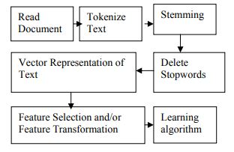
METHODOLOGY USED

Slide 11
SYSTEM REQUIREMENTS
SOFTWARE REQUIREMENTS:
Operating System : Windows 7, 10 or Higher Versions
Front End : Tkinter
Back End : Python and Modules
Programming Language : Python
HARDWARE REQUIREMENTS:
System : Intel Core i3 or above
RAM : 512 MB or above
Hard Disk : 10 GB or above
Input Device : Keyboard and Mouse
Output Device : Monitor

Slide 12
MODULES
Tkinter: It is used to create User Interface(UI).
Scikit Learn (sklearn): It will contain Machine Learning Algorithms like Naive Bayes which is used in our project.
Natural Language Toolkit (NLTK): It will contain language based methods to analyze the text which is taken as input.
Numpy: It is used to do matrix calculations efficiently.
Pandas: It will have the efficient data types to easily load and analyze the raw data which is in the form of a file or this module can extract the data from the url also.

Slide 13
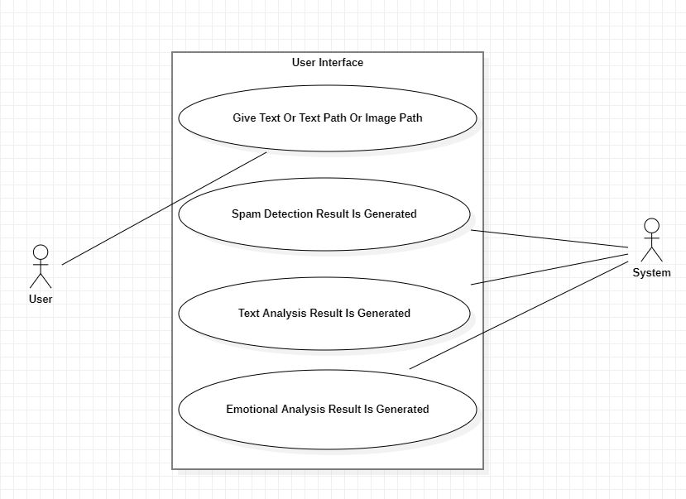
UML DIAGRAMS
Use Case Diagram:

Slide 14
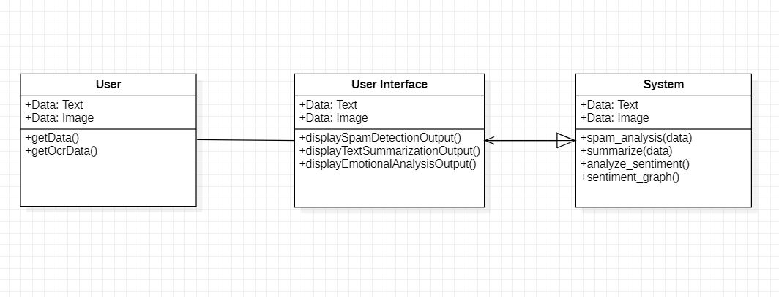
Class Diagram:

Slide 15
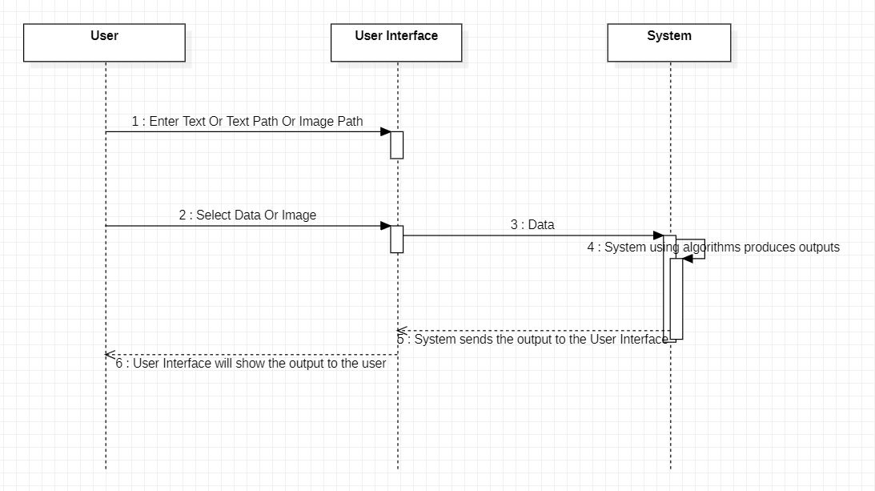
Sequence Diagram:

Slide 16
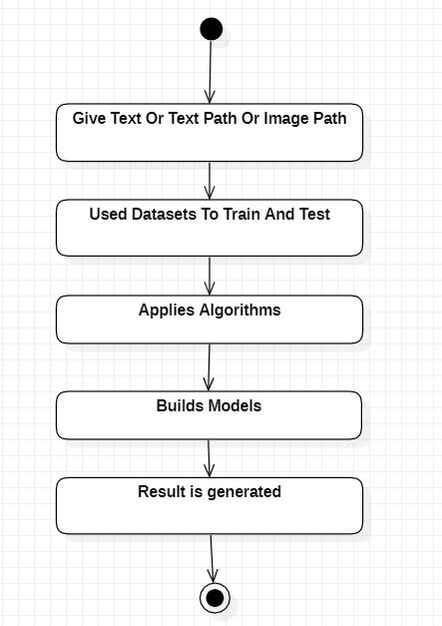
Activity Diagram:

Slide 17
SAMPLE CODE
import tkinter
import Spam_Detection
import Text_Summarization
import Emotional_Analysis
import threading
import subprocess
import OCR
# Window settings
window = tkinter.Tk()
window.title("Text Analysis")
# Variables
path = ""
img = ""

Slide 18
# Methods
def loadData(e=""):
global graph_display, path, img
path = tkinter.filedialog.askopenfilename(title="Open", filetype=((".txt | .png | .jpg", "*.*"),)).lower()
if path.endswith(".txt"):
text = ""
with open(path, "r", encoding="utf-8") as p:
text = p.read()
text_display.delete(1.0, tkinter.END)
text_display.insert(tkinter.INSERT, text)
elif path.endswith(".png") or path.endswith(".jpg") or path.endswith(".jpeg"):
text = getOcrData(path)
text_display.delete(1.0, tkinter.END)
text_display.insert(tkinter.INSERT, text)

Slide 19
def getOcrData(path):
ocr_obj = OCR.Ocr()
text = ocr_obj.imgToText(path).strip()
if text == "":
tkinter.messagebox.showwarning("Warning", "OCR algorithm did not detected any text in the selected image.")
return ""
return text
def displaySpamDetectionOutput():
text = text_display.get(1.0, tkinter.END).strip()
if text == "":
tkinter.messagebox.showwarning("Warning", "Load the text or enter text in the text box.")
return

Slide 20
def displayTextSummarizationOutput():
text = text_display.get(1.0, tkinter.END).strip()
if text == "":
tkinter.messagebox.showwarning("Warning", "Load the text or enter text in the text box.")
return
text_summarization_obj = Text_Summarization.Summarization()
summarized_text = text_summarization_obj.summarize(text)
with open("Summarized_Text.txt", "w", encoding="utf-8") as p:
p.write(summarized_text)
if summarized_text.strip() == "":
tkinter.messagebox.showwarning("Warning", "You have not provided the enough text to the algorithm try to give a big paragraph.")
return ""

Slide 21
def displayEmotionalAnalysisOutput():
global img
text = text_display.get(1.0, tkinter.END).strip()
if text == "":
tkinter.messagebox.showwarning("Warning", "Load the text or enter text in the text box.")
return
emotional_analysis_obj = Emotional_Analysis.Emotions(text)
emotion = emotional_analysis_obj.analyze_sentiment()
emotional_analysis_obj.sentiment_graph()
print(emotion)
img = tkinter.PhotoImage(file="Dependencies/graph.png")
if emotion == "Positive Sentiment":
sentiment_lbl.config(bg="green", text=emotion, fg="white")
graph_display.config(image=img)

Slide 22
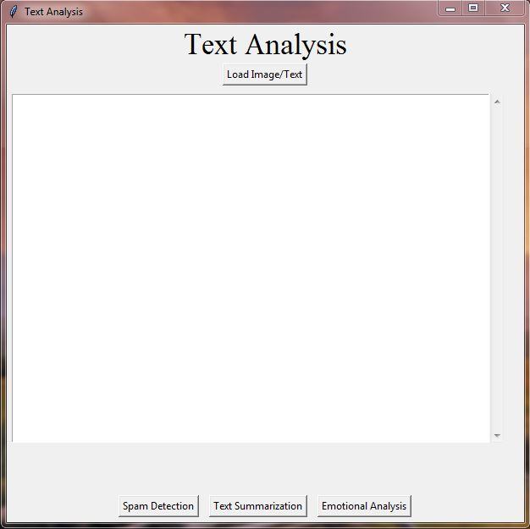
SCREENSHOTS

Slide 23
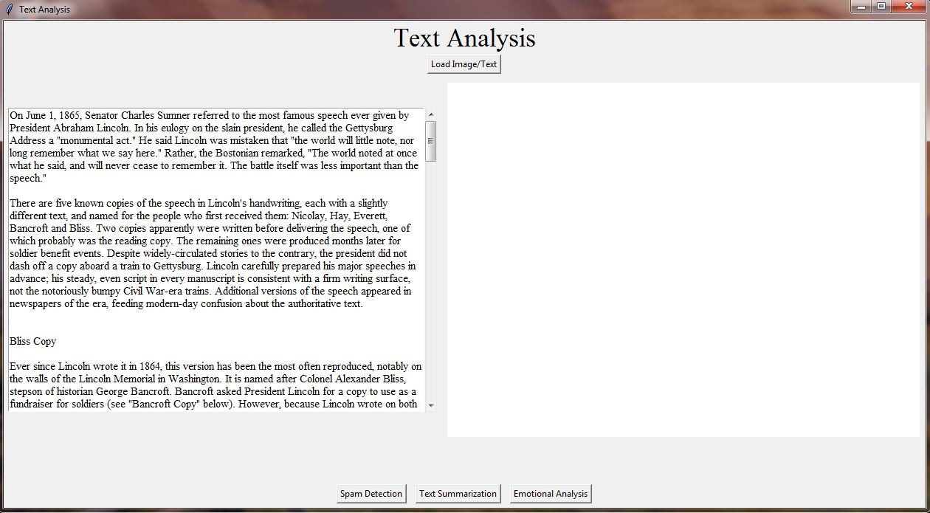
SCREENSHOTS

Slide 24
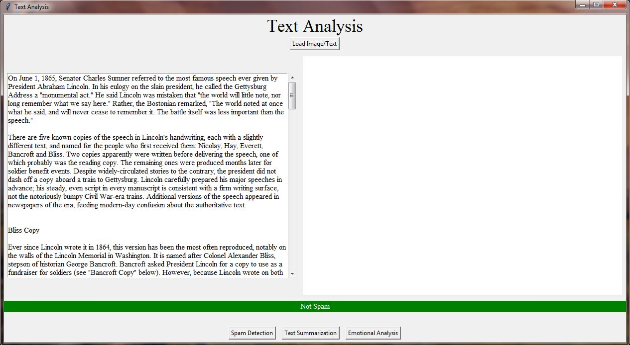
SCREENSHOTS

Slide 25
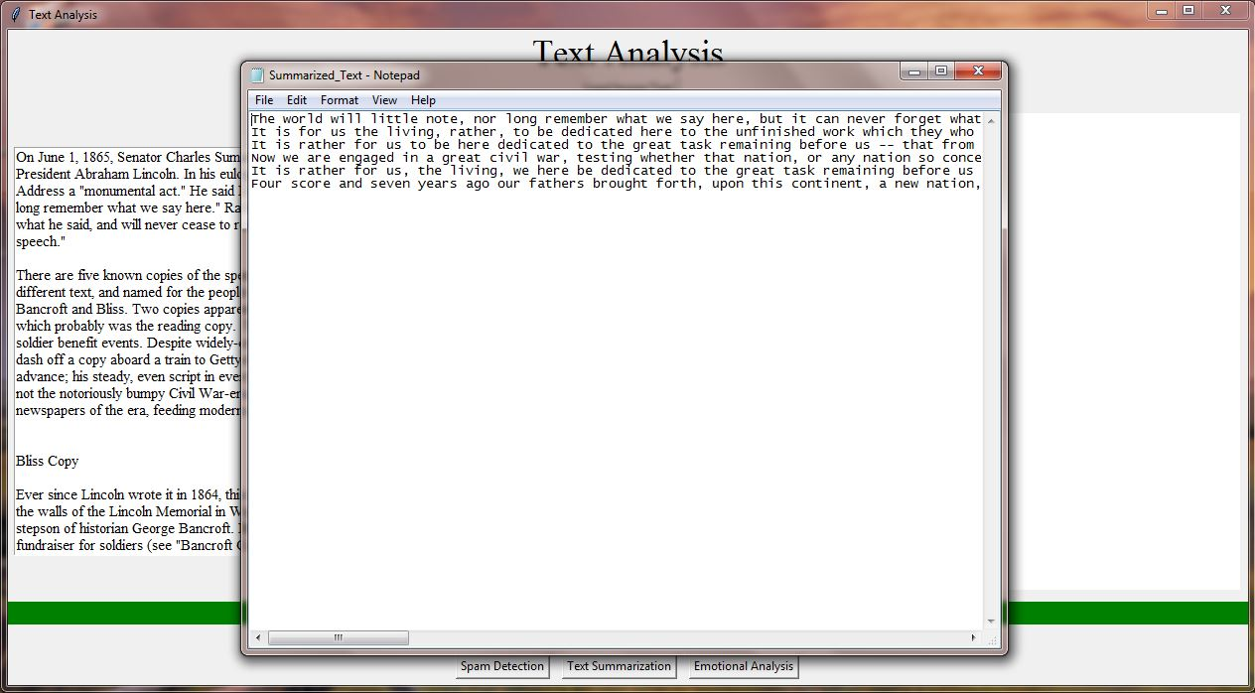
SCREENSHOTS

Slide 26
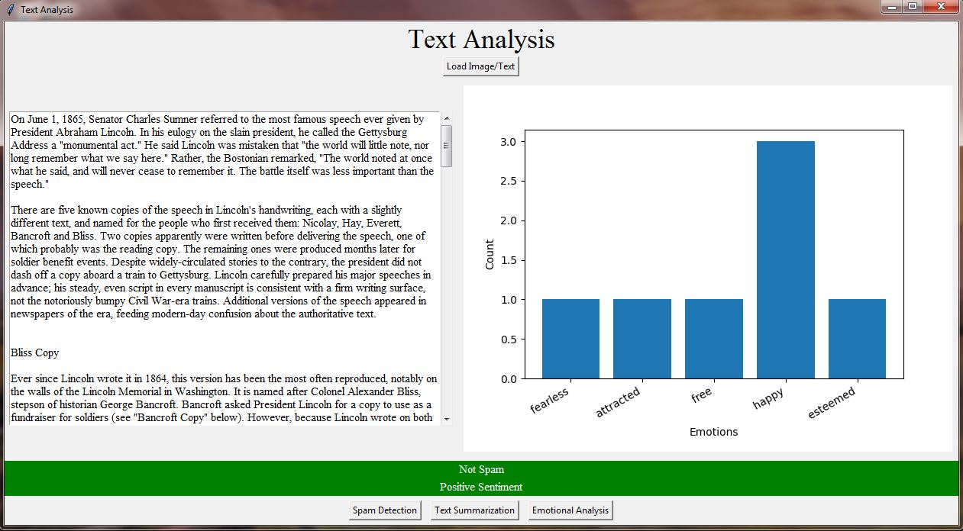
SCREENSHOTS

Slide 27
CONCLUSION
So, finally I conclude that this project created with spam detector, text summarization, and emotional analysis is a powerful NLP system that can assist users in managing their text and textual data more effectively. The integration of these three modules provides a comprehensive tool for managing textual data and analyzing the text that improves communication efficiency and reduces the risk of security threats. The spam detector module accurately identifies and filters out unwanted or unsolicited messages, saving time and reducing the risk of falling prey to scams or phishing attacks. The text summarization module condenses large amounts of text data into shorter summaries, allowing users to quickly identify key information and make informed decisions. The emotional analysis module provides insight into the tone and sentiment of the message, allowing users to gauge the emotional content of the message and respond appropriately. This project involves the development of various algorithms and techniques for natural language processing, machine learning, and data analysis, which can be tailored to the specific needs and requirements of the users. And this project will have an interactive user interface which will make the whole experience a little bit better. This project can read the txt files and also extract data from images using OCR algorithm. Overall, the project has the potential to significantly improve communication efficiency and decision-making in various contexts, including email management, social media analysis, and customer feedback analysis. As NLP technology continues to advance, the potential applications of this project are vast and exciting.

Slide 28
FUTURE ENHANCEMENTS
There are several potential future enhancements for the project created with spam detector, text summarization, and emotional analysis. Some of these include:
Multilingual support: The system could be enhanced to support multiple languages, allowing users to analyze messages in different languages.
Contextual analysis: The emotional analysis module could be improved to take into account the context of the message, allowing for more accurate emotional analysis.
Integration with other tools: The system could be integrated with other tools, such as calendar and task management systems, to provide a more comprehensive solution for managing messages and tasks.
Personalization: The system could be enhanced to personalize the analysis based on the user's preferences and history, improving the accuracy and relevance of the analysis.
Integration with voice assistants: The system could be integrated with voice assistants such as Siri, Alexa, or Google Assistant, allowing users to manage their messages using voice commands.

Slide 29
BIBLIOGRAPHY
Almeida, T.A., & Hidalgo, J.M.G. (2011). Using Machine Learning to Combat Spam: An Evaluation. IEEE Intelligent Systems, 26(4), 80-84.
Nallapati, R., Zhai, F., & Zhou, B. (2017). Summarunner: A Recurrent Neural Network based Sequence Model for Extractive Summarization of Documents. Proceedings of the Conference on Empirical Methods in Natural Language Processing, 214-223.
Liu, B. (2012). Sentiment Analysis and Opinion Mining. Morgan & Claypool Publishers.
Llorente, A., & García-Serrano, A. (2018). Text Mining and Social Media: When Quantitative Meets Qualitative, and Software Meets Humans. Journal of Business Research, 89, 205-211.
Chen, Y., Feng, S., & Wu, D. (2018). A Review of Natural Language Processing Techniques for Opinion Mining Systems. Information Fusion, 45, 162-179.
Agarwal, A., & Vohra, M. (2017). Emotion Detection from Text Using Machine Learning: A Review. International Journal of Computer Applications, 173(4), 11-18.
Medhat, W., Hassan, A., & Korashy, H. (2014). Sentiment Analysis Algorithms and Applications: A Survey. Ain Shams Engineering Journal, 5(4), 1093-1113.
Datta, S., Li, J., & Wang, J.Z. (2008). Algorithmic Approaches to Detecting Unwanted Webpages. IEEE Transactions on Knowledge and Data Engineering, 20(8), 1075-1088.
Jurafsky, D., & Martin, J.H. (2019). Speech and Language Processing. Pearson Education.
Manning, C.D., Raghavan, P., & Schütze, H. (2008). Introduction to Information Retrieval. Cambridge University Press.

Slide 30
Thank You

